Slide 1




COMPANY PROFILE
WORRY-FREE CONSTRUCTION.
New Vision Integral for Maintenance & Contracting
Engineering · Contracting · Fit-Out · MEP · Facility Maintenance
Jeddah · Kingdom of Saudi Arabia
www.nvi-sa.com

Slide 2
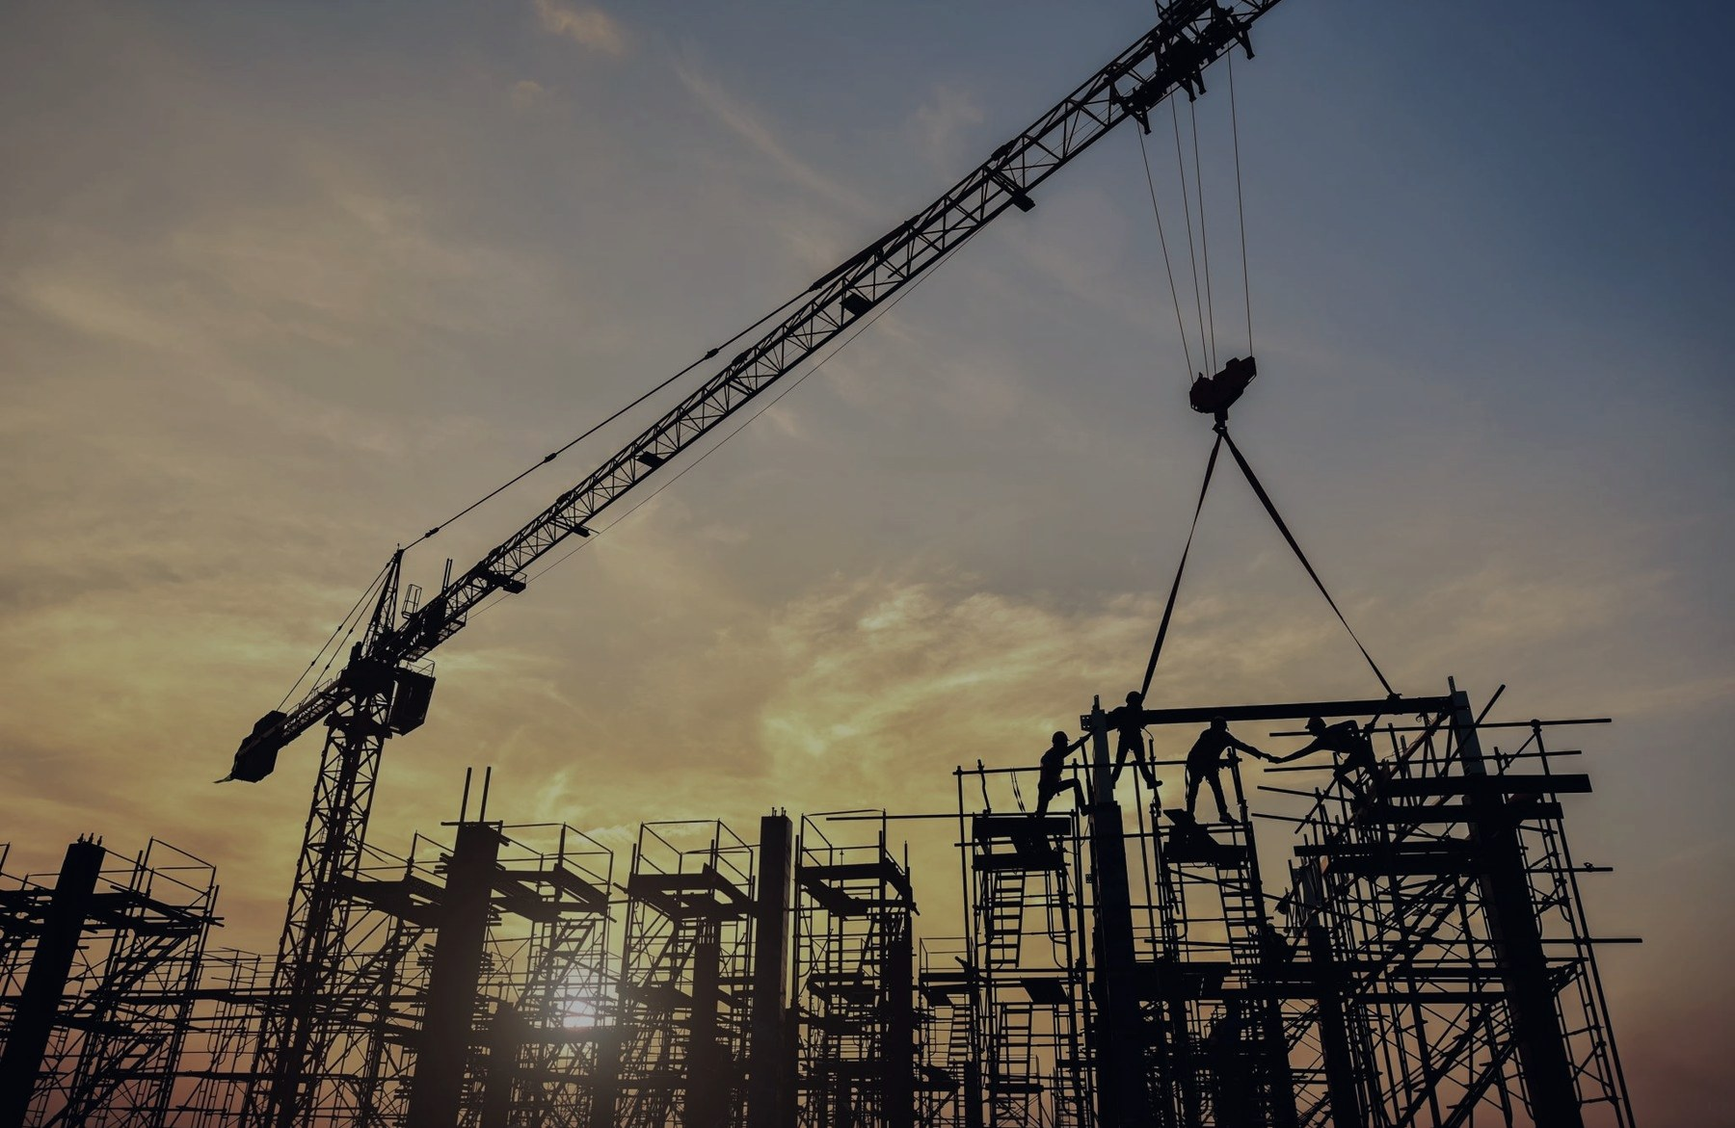
01
WHO WE ARE
2024
Jeddah
35+
8
Established
Headquarters
Years of expertise
Service lines
A new Jeddah contractor, backed by 35+ years of expertise.
New Vision Integral for Maintenance & Contracting is a Jeddah-based company established in 2024, providing comprehensive maintenance and contracting solutions tailored to each client's needs.
Our team brings over 35 years of hands-on expertise, and our central Jeddah location lets us serve a diverse range of sectors efficiently.
NEW VISION INTEGRAL · COMPANY PROFILE
02

Slide 3
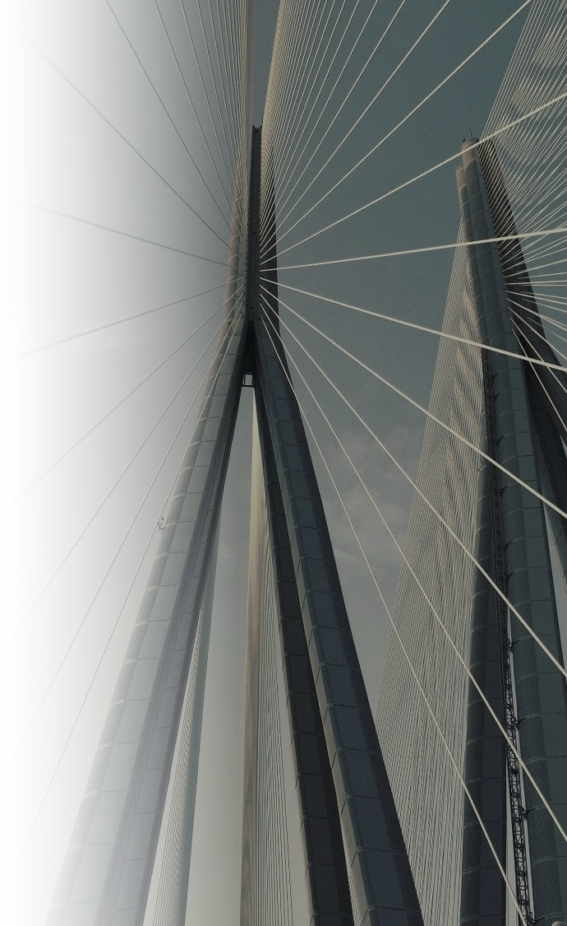
02
VISION, MISSION & VALUES
Our Vision
To become a leading building firm, from creative design solutions and maintenance to execution and delivery, that resolves our clients' social, environmental and economic needs.
Our Mission
To earn our clients' trust and satisfaction, and build long-term relationships through the projects we deliver and maintain.
What we stand for
01
Customer satisfaction, never compromised
02
Integrity & honesty
03
Effective, principled management
04
Continuous development
NEW VISION INTEGRAL · COMPANY PROFILE
03

Slide 4

03
OUR APPROACH
Worry-Free Construction
We don't just build things. We are committed to enhancing people's lives through the built environment. Doing the job properly the first time, with preventive maintenance planned from the beginning, delivers long-term savings for our clients.
01
02
03
04
Accurate Engineering
Detail-Oriented Project Management
Timely Communication
Preventive Maintenance
Getting it right the first time.
Every phase planned, tracked and controlled.
Clients kept informed at every stage.
Planned from day one for long-term savings.
NEW VISION INTEGRAL · COMPANY PROFILE
04

Slide 5
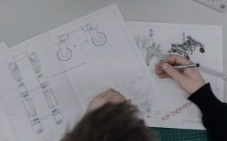
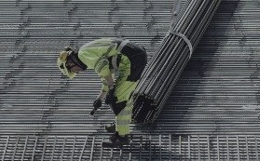
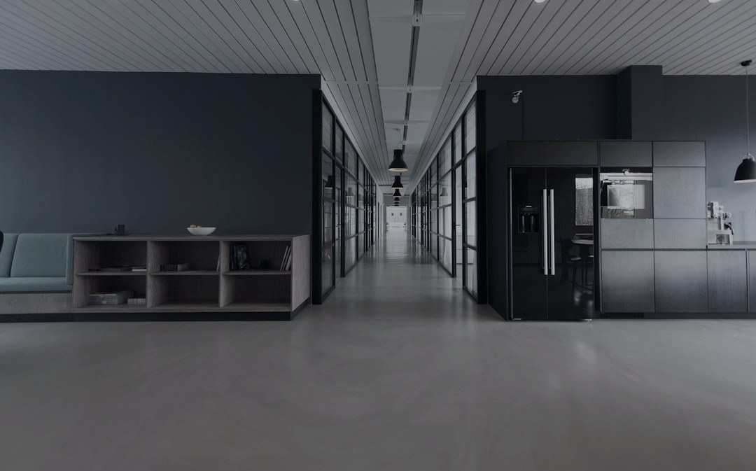
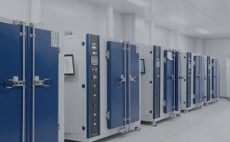
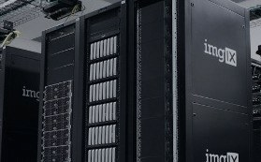
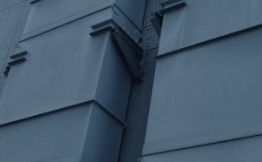
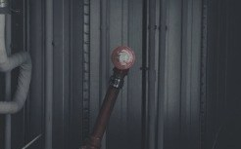

04
WHAT WE DO
Eight integrated service lines. One accountable partner.
04.1
Engineering & Planning
04.2
Contracting & Structure
04.3
Fit-Out & Finishing
04.4
Electrical Works
04.5
Low Current Systems
04.6
Mechanical & HVAC
04.7
Plumbing & Fire Fighting
04.8
Facility Maintenance
NEW VISION INTEGRAL · COMPANY PROFILE
05

Slide 6
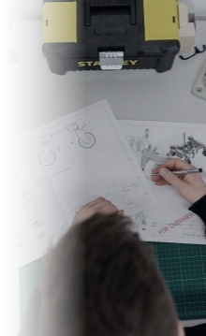
04.1
ENGINEERING & PLANNING
Disciplined project management applied end to end, from feasibility to handover.
PHASE 01
PHASE 02
Define & Evaluate
Select & Plan
Project definition & characteristics
Portfolio, programme & operations alignment
Business performance & strategic planning
Feasibility study & project evaluation
Commercial vs. governmental profitability criteria
Project selection & project charter
Scope planning & master schedule
Cost, quality & human-resources planning
PHASE 03
PHASE 04
Control
Execute & Close
Communications, risk & opportunity management
Needs & supplies planning
Analysis methods & change requests
Project phases & their management
Organisation & execution
Closure & project delivery
NEW VISION INTEGRAL · COMPANY PROFILE
06

Slide 7

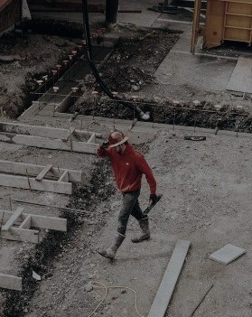
04.2
CONTRACTING & STRUCTURE
Core structural contracting, led by a civil engineer with 35 years' experience, including Saudi Binladen Group.
01
Concrete Works
02
Steel Works
35
years of civil engineering leadership
NEW VISION INTEGRAL · COMPANY PROFILE
07

Slide 8
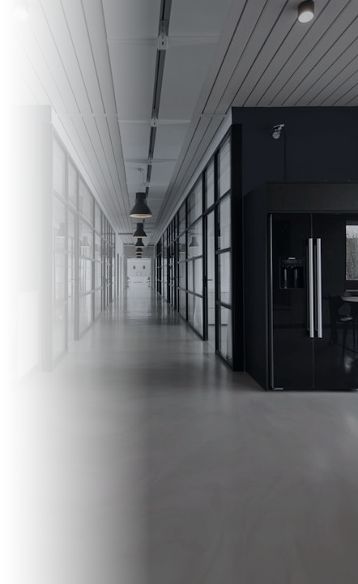


04.3
FIT-OUT & FINISHING
Interior design and every finishing trade, delivered under one roof.
01
Interior design & fit-out
05
Glass works
02
Landscaping works
06
Painting works
03
Tile works
07
Gypsum works
04
Woodworking
08
Aluminium & metal structures
NEW VISION INTEGRAL · COMPANY PROFILE
08

Slide 9

04.4
ELECTRICAL WORKS
Complete electrical installation, from main cables to the final point.
01
Lighting fixtures & points
02
Raceways & cabling
03
Power outlets
04
Electrical panels
05
Main cables
06
Grounding & earthing systems
07
Lightning protection systems
NEW VISION INTEGRAL · COMPANY PROFILE
09

Slide 10
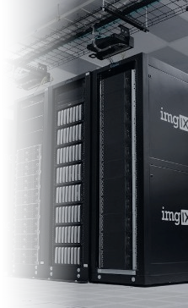
04.5
LOW CURRENT SYSTEMS
Integrated building systems for data, safety, security and communications.
01
Data systems
07
Access control systems
02
IP telephone systems
08
Master clock systems
03
Fire alarm systems
09
Building management systems (BMS)
04
CCTV systems
10
IPTV & audio / video systems
05
Public address systems
11
Intercom systems
06
Nurse call systems
11
integrated systems, one installer
NEW VISION INTEGRAL · COMPANY PROFILE
10

Slide 11
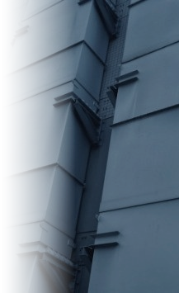
04.6
MECHANICAL & HVAC
Cooling, air handling and air distribution systems.
01
Chillers & package units
02
Fan coil & air handling units (FCU / AHU)
03
Ductwork & grilles
04
Cold & hot water piping
NEW VISION INTEGRAL · COMPANY PROFILE
11

Slide 12
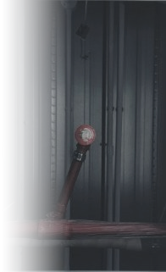
04.7
PLUMBING & FIRE FIGHTING
Water supply, drainage and fire-fighting networks.
PLUMBING
FIRE FIGHTING
01
Sanitary fixtures
05
Fire-fighting piping & pumps
02
Cold & hot water piping
06
Valves, insulation & fittings
03
Water & submersible pumps
07
Fire hose cabinets & sprinklers
04
Sewage piping
NEW VISION INTEGRAL · COMPANY PROFILE
12

Slide 13
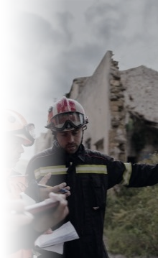
04.8
FACILITY MAINTENANCE
Preventive maintenance, planned from the beginning, to protect our clients' investment over the long term.
01
Buildings & exterior façades
05
Networks & CCTV
02
Interior decoration
06
Mechanical works & air conditioning
03
Electrical works
07
Plumbing works
04
Low-voltage systems
NEW VISION INTEGRAL · COMPANY PROFILE
13

Slide 14

05
TRUSTED BY ESTABLISHED BRANDS
A selection of the clients we have delivered for.
CLIENT 01
CLIENT 02
CLIENT 03
DUKAN
PANDA
MAZDA
Dabbagh Group
Savola Group
Haji Husein Alireza & Co. Ltd.
NEW VISION INTEGRAL · COMPANY PROFILE
14

Slide 15
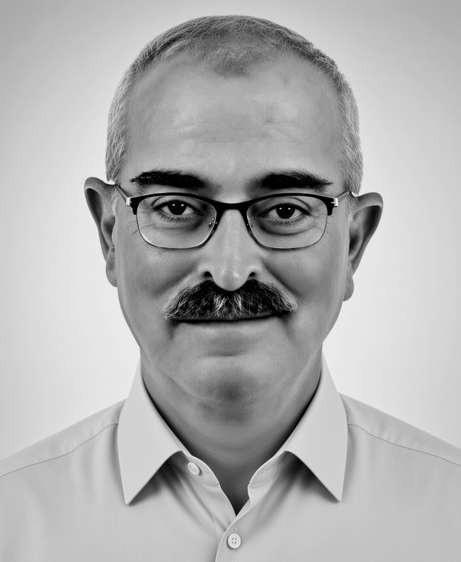
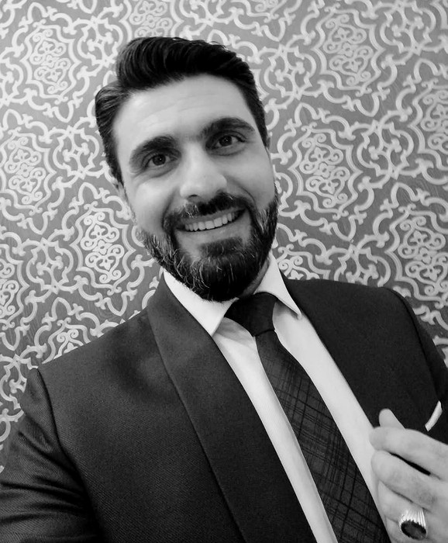
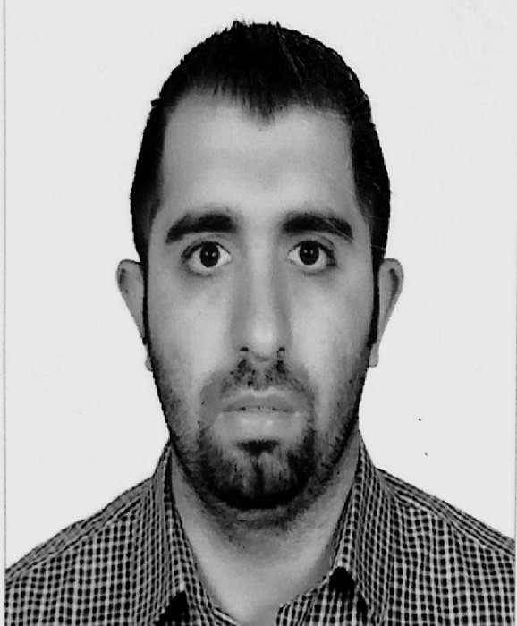
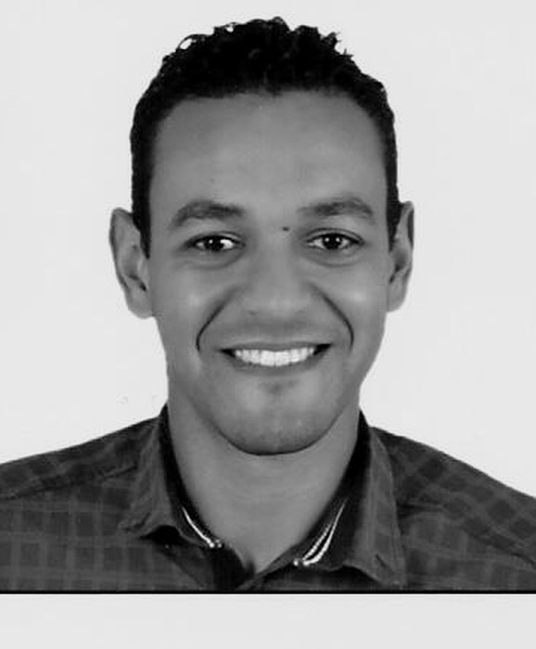
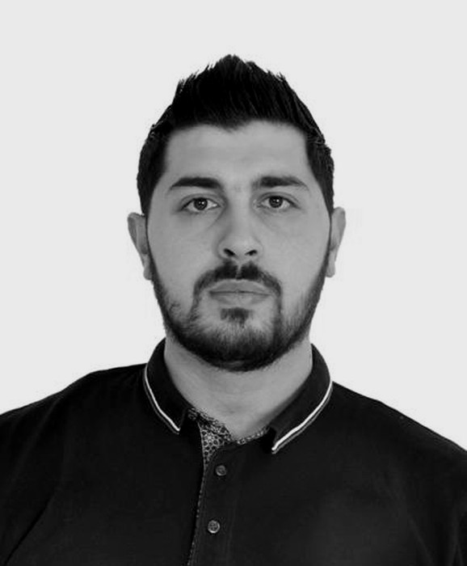
06
LEADERSHIP
PROJECT MANAGER
PROJECT MANAGER
PROJECT MANAGER
PROJECT MANAGER
Hazem Ghorbal
Mohammad Khayat
Nader M. Abdulhadi
Anas Khayat
Interior Designer
Network Engineer
Electrical Engineer
Mechanical Engineer
18
years' experience
15
years' experience
11
years' experience
5
years' experience
GENERAL MANAGER
Azzam Al Sayeh
Civil Engineer · 35 years' experience, including Saudi Binladen Group
NEW VISION INTEGRAL · COMPANY PROFILE
15

Slide 16
New Vision Integral for Maintenance & Contracting
GENERAL MANAGER
MANAGING DIRECTOR
Azzam Al Sayeh
Abdulhai Hambrouch
a.alsayeh@nvi-sa.com
a.ahmed@nvi-sa.com
+966 50 597 6970
+966 55 069 6190
www.nvi-sa.com
Jeddah · Kingdom of Saudi Arabia
NEW VISION INTEGRAL · COMPANY PROFILE
16

